Slide 1
Week 4(10.23-10.30) Progress Report
Siyu Zhang
10.30

Slide 2
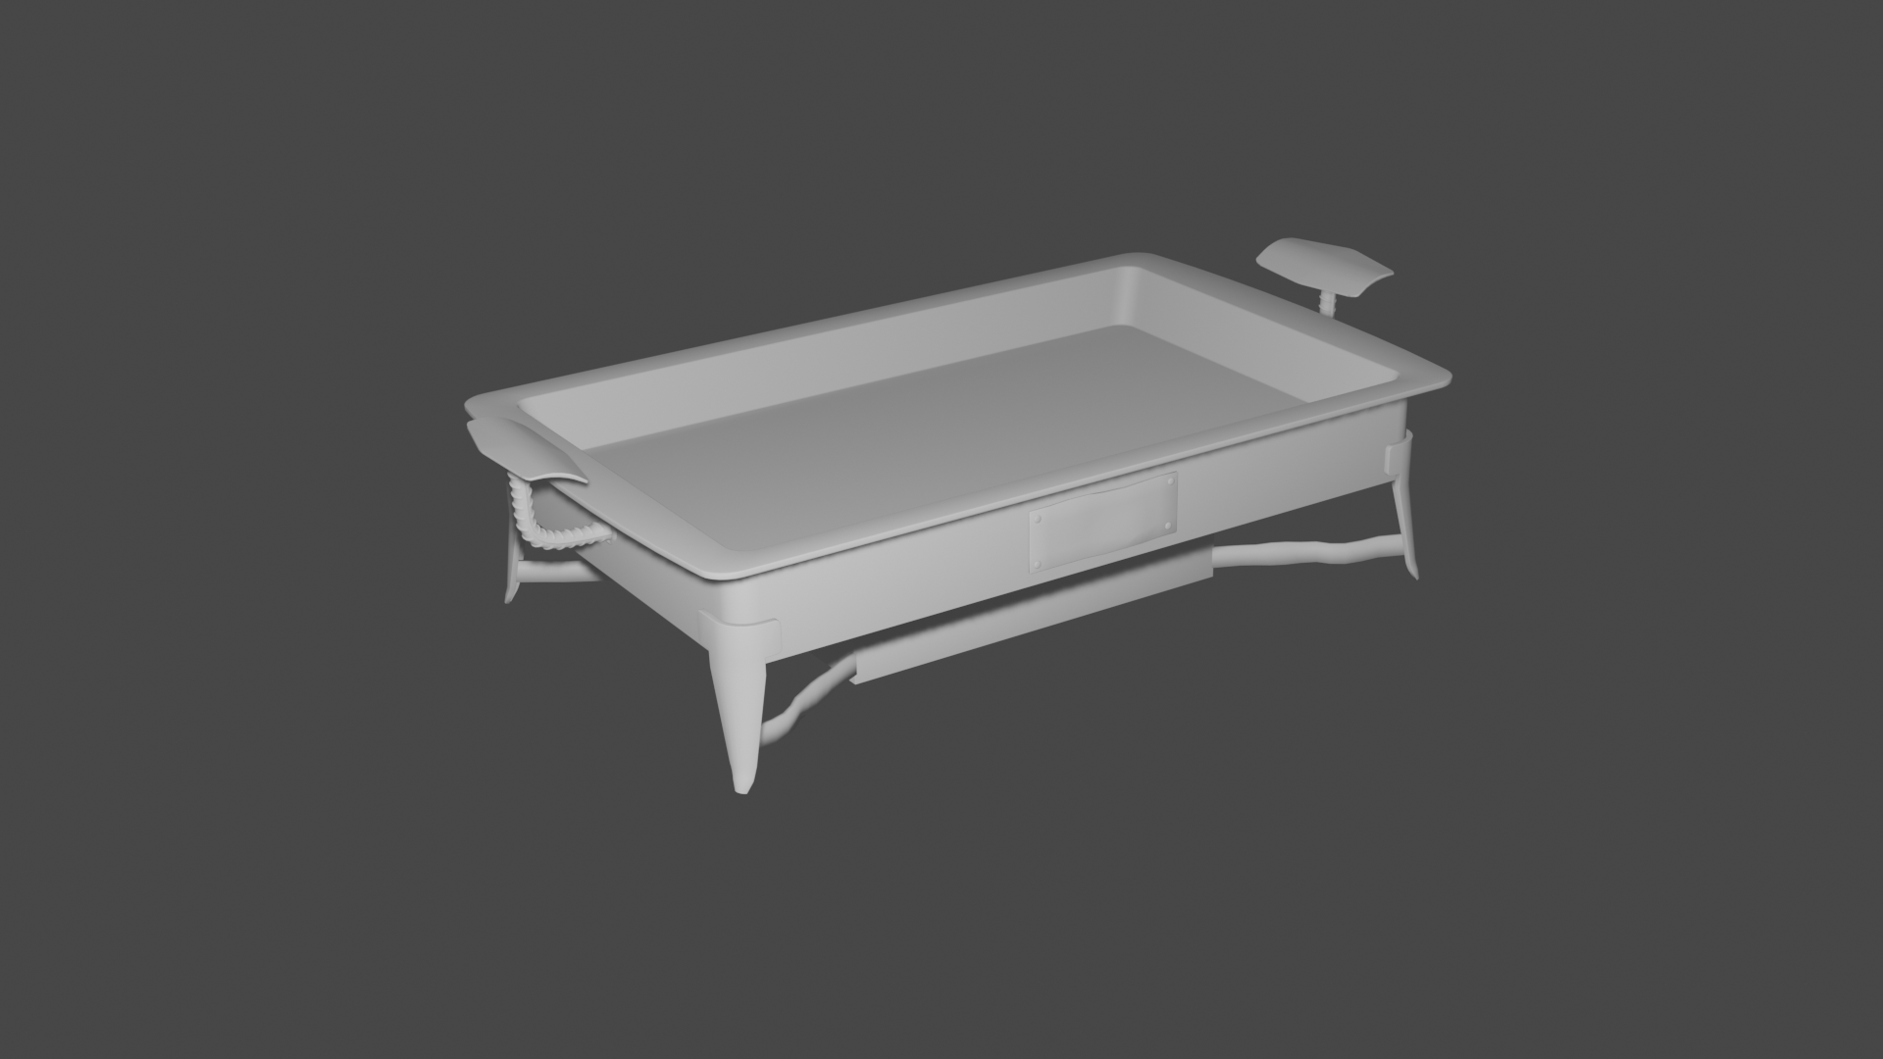
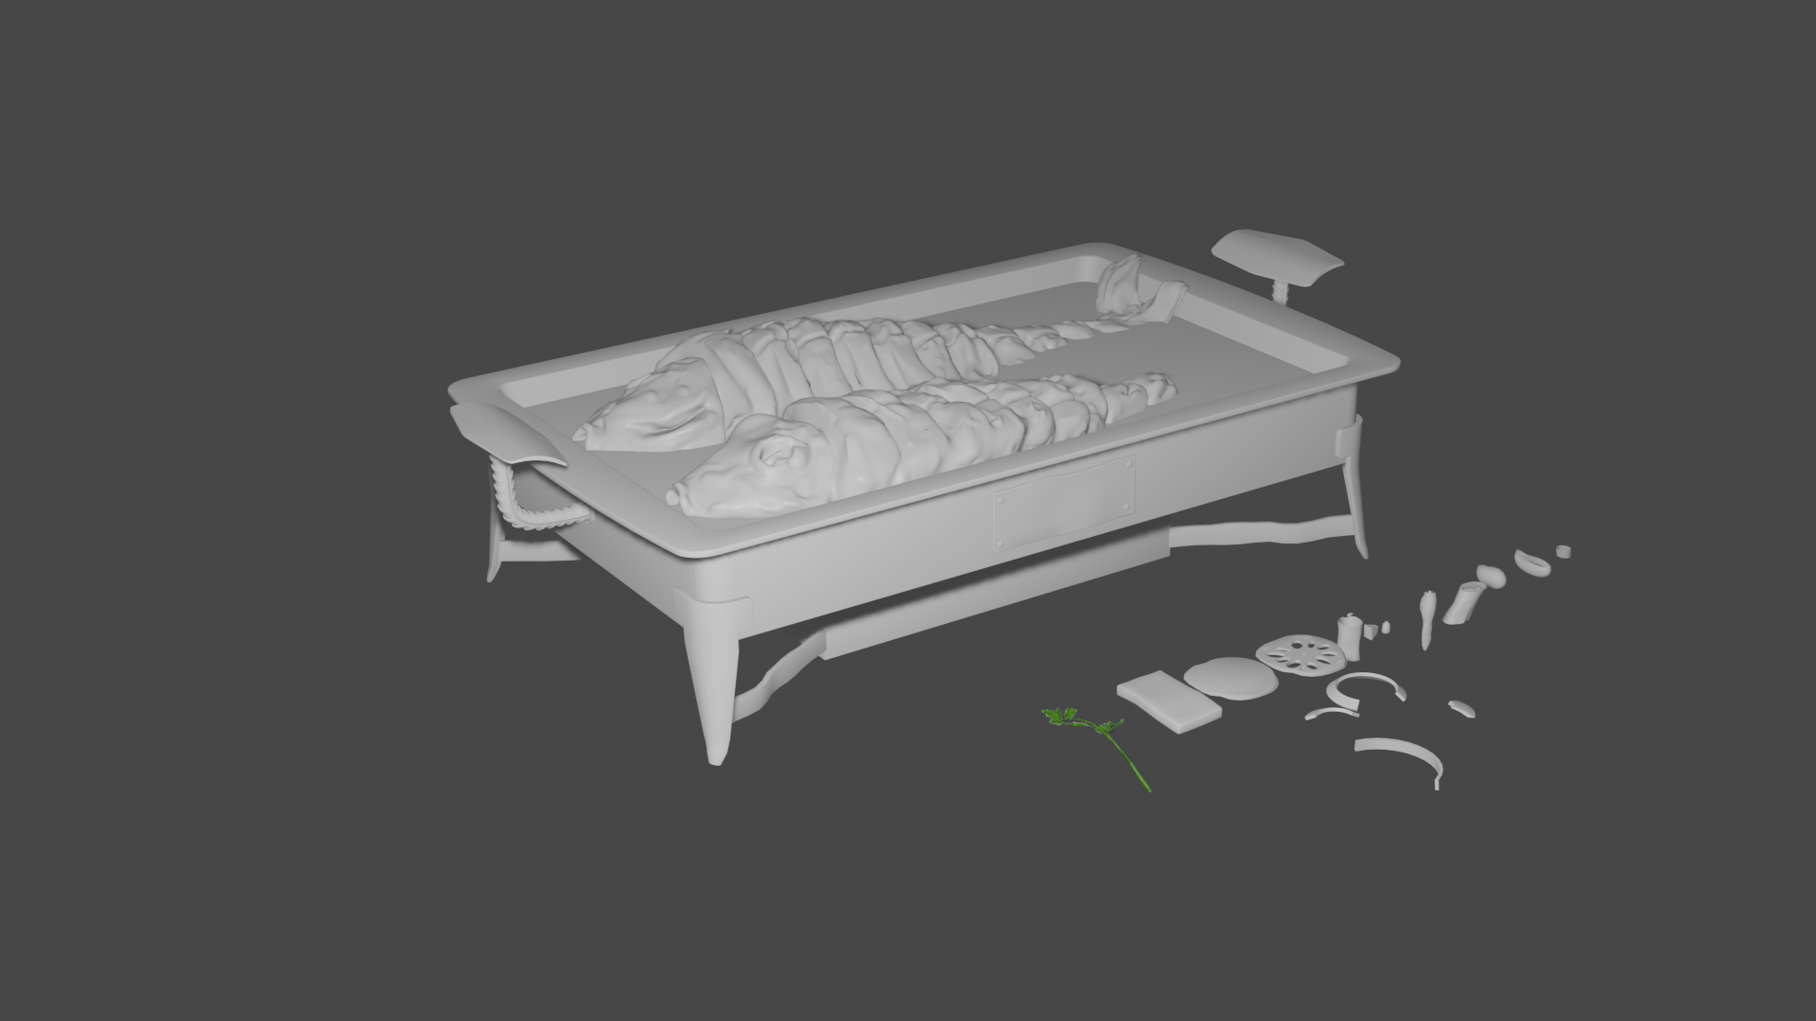
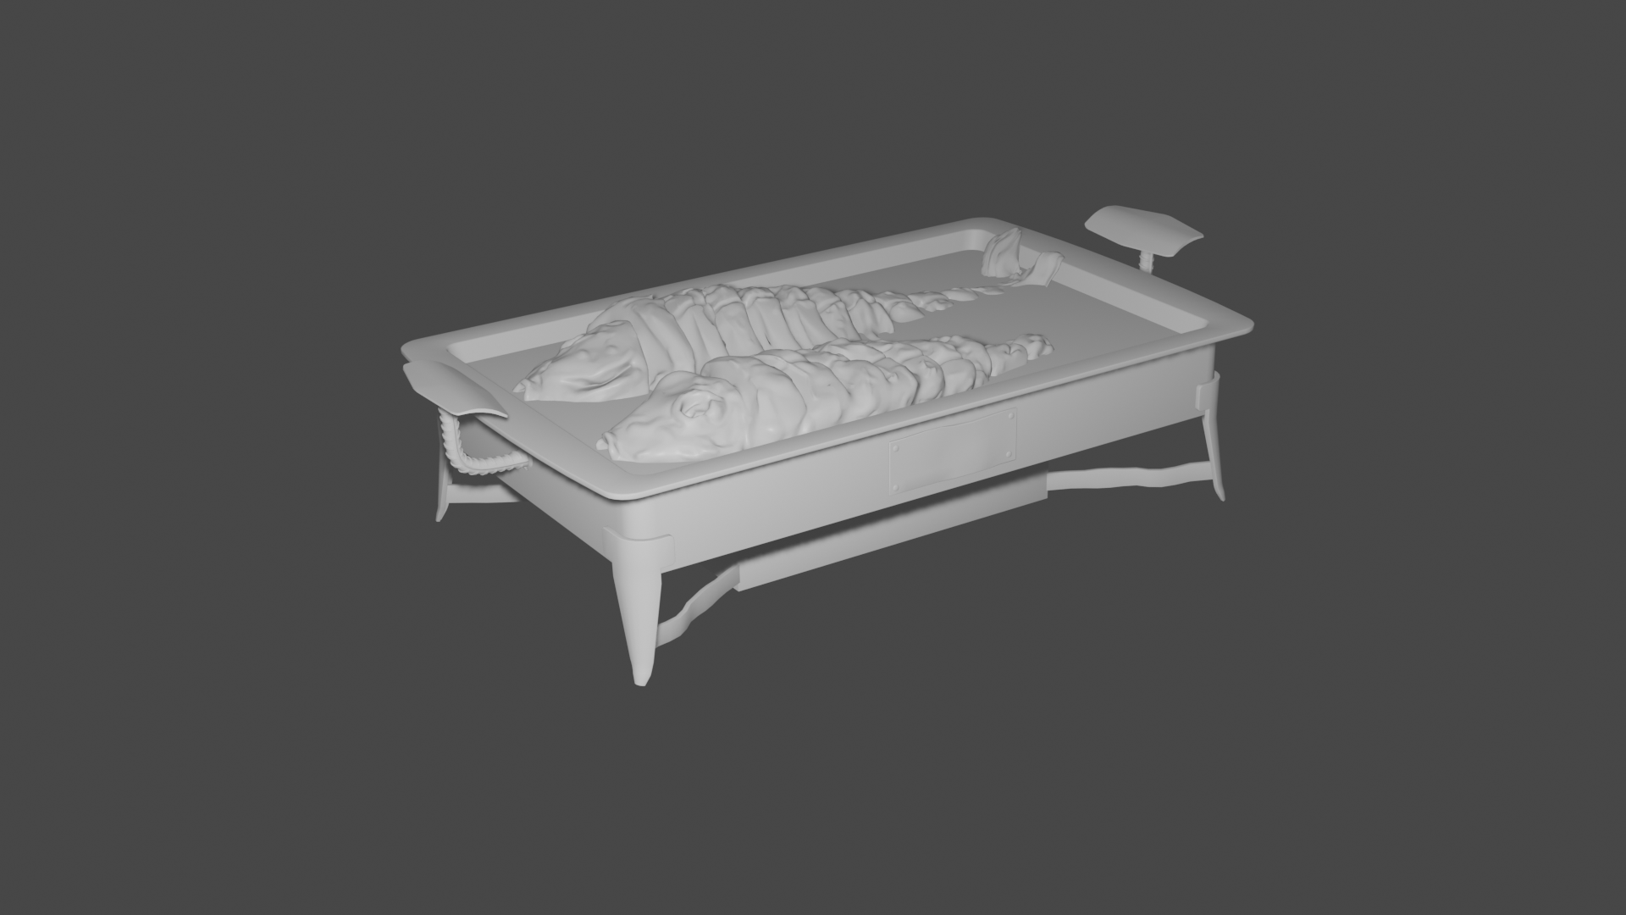
Update: Modeling
Finished the modeling of the plate, fish and some vegetables

Slide 3
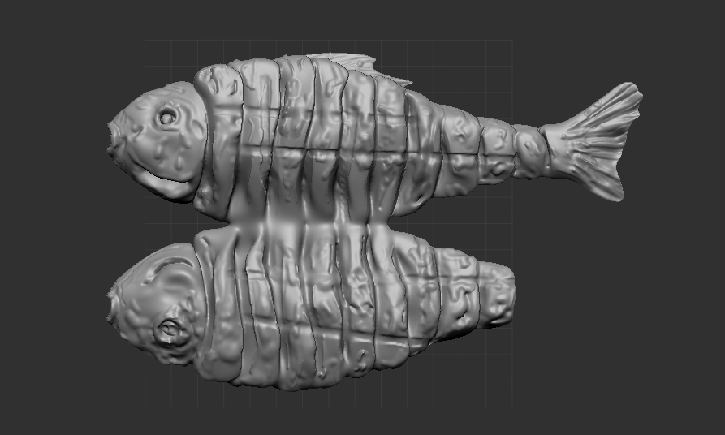
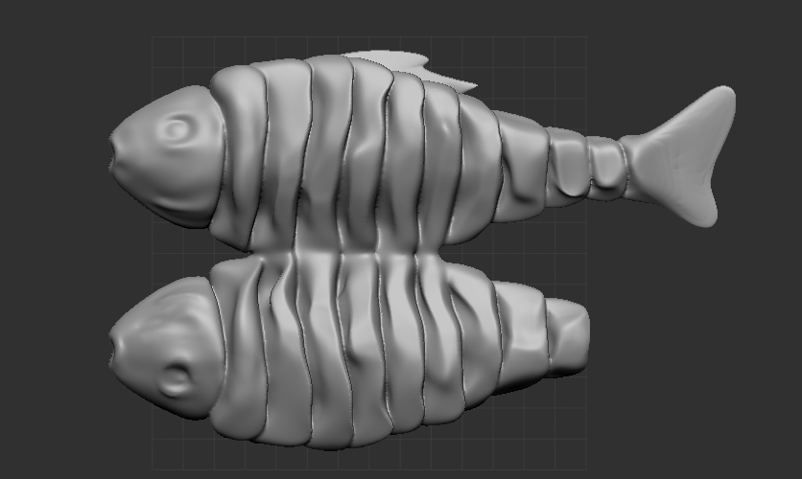

Update: Modeling
Finished the modeling of the plate, fish and some vegetables
Sculpting the fish with Zbrush and then imported it into Blender with an add-on

Slide 4
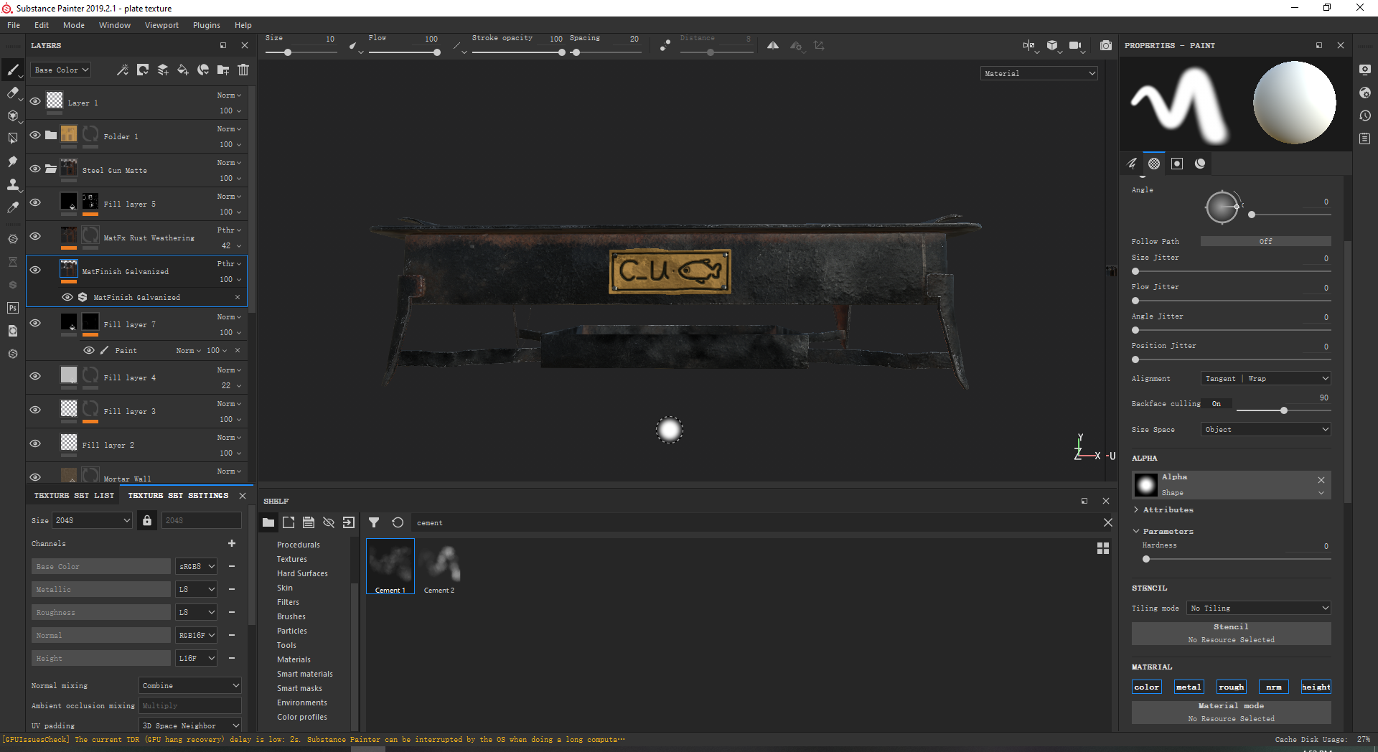
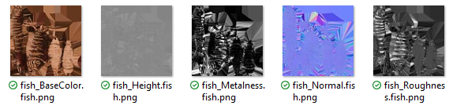
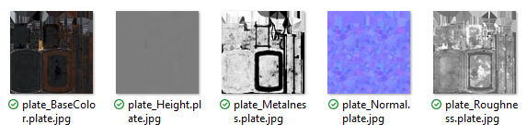

Update: uv and texture
Unwrap the UVs of the models for texture painting
Using Substance Painter to paint the textures

Slide 5
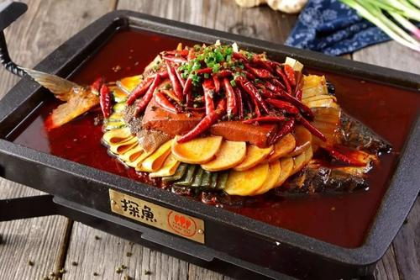
Liquid: soup and oil
Glossy Metal:
Iron Plate

Slide 6
Takeaways for this week
Blender Modeling
Blender UV Editing
ZBrush Sculpting
Substance Painter for textures

Slide 7
Plan for the next week
Finish the textures of the Grilled Fish
Adjust shading and lighting for creating photo-realistic style
Spend more time on analyzing Cycles Engine

